Slide 1
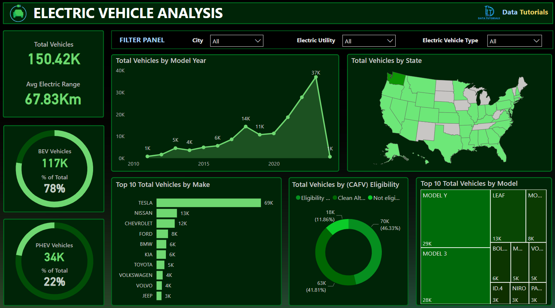
BUSINESS UNDERSTANDING :
The aim of this project is to analyze electric vehicle (EV) adoption trends across the U.S. using public EV registration data. The dashboard helps stakeholders, such as policymakers, automotive manufacturers, and utility companies, understand the distribution, growth, and characteristics of EV usage to guide strategic planning, marketing, and infrastructure development.
Project Description:
This project involves creating an interactive and insightful Tableau dashboard using real-world EV registration data. The analysis covers:
KPI Metrics such as total vehicles, average electric range, and top EV manufacturers/models.
Trend Analysis showing how EV adoption has grown over time and how factors like model year or MSRP impact range and sales.
Geographical Insights highlighting top states and electric utilities contributing to EV adoption.Vehicle Characteristics including make, model, type (BEV/PHEV), MSRP, and range distribution.User Interactivity through dynamic filters for CAFV eligibility, EV type, model, state, and utility.
The dashboard is divided into multiple pages, each focusing on a different analytical angle—ranging from EV make/model popularity, electric range analysis, CAFV eligibility, and electric utility performance—to deliver a 360° view of the EV landscape in the selected region.

Slide 2
PROBLEM STATEMENT
KPI’S Requirement
Total Vehicles:
Understand the overall landscape of electric vehicles, encompassing both BEVs and PHEVs, to assess the market's size and growth.
2. Average Electric Range:
Determine the average electric range of the electric vehicles in the dataset to gauge the technological advancements and efficiency of the EVs.
3. Total BEV Vehicles and % of Total BEV Vehicles:
Identify and analyze the total number of Battery Electric Vehicles (BEVs) in the dataset.
Calculate the percentage of BEVs relative to the total number of electric vehicles, providing insights into the dominance of fully electric models.
4. Total PHEV Vehicles and % of Total PHEV Vehicles:
Identify and analyze the total number of Plug-in Hybrid Electric Vehicles (PHEVs) in the dataset.
Calculate the percentage of PHEVs relative to the total number of electric vehicles, offering insights into the market share of plug-in hybrid models.

Slide 3
PROBLEM STATEMENT
Charts Requirement
Total Vehicles by Model Year (From 2010 Onwards):
Visualization: Line/ Area Chart
Description: This chart will illustrate the distribution of electric vehicles over the years, starting from 2010, providing insights into the growth pattern and adoption trends.
2. Total Vehicles by State:
Visualization: Map Chart
Description: This chart will showcase the geographical distribution of electric vehicles across different states, allowing for the identification of regions with higher adoption rates.
3. Top 10 Total Vehicles by Make:
Visualization: Bar Chart
Description: Highlight the top 10 electric vehicle manufacturers based on the total number of vehicles, providing insights into the market dominance of specific brands.
4. Total Vehicles by CAFV Eligibility:
Visualization: Pie Chart or Donut Chart
Description: Illustrate the proportion of electric vehicles that are eligible for Clean Alternative Fuel Vehicle (CAFV) incentives, aiding in understanding the impact of incentives on vehicle adoption.
5. Top 10 Total Vehicles by Model:
Visualization: Tree map
Description: Highlight the top 10 electric vehicle models based on the total number of vehicles, offering insights into consumer preferences and popular models in the market.

Slide 4
PROBLEM STATEMENT
KPI’S Requirement
Top State and Vehicle Count :
Identify the state with the highest number of registered electric vehicles and understand its contribution to the overall dataset.
2. Number of Unique EV Makes and Models :
Analyze the diversity of the electric vehicle market by evaluating the total number of unique EV makes and models available in the dataset.
3. Average Model Year :
Determine the average manufacturing year of EVs to assess how recent or dated the vehicle population is.

Slide 5
PROBLEM STATEMENT
Charts Requirement
Average Electric Range by Make :
Visualization : Packed Bubble Chart
Description : Display different EV makes based on their average electric range, giving a visual overview of which manufacturers offer better battery performance.
Average Electric Range by Model Year :
Visualization : Line Chart
Description : Track the trend in electric range capabilities over time, providing insights into how EV technology has evolved.
Electric Range Distribution :
Visualization: Bar Chart (Stacked by Make)
Description: Show the distribution of electric range across various makes to highlight variation and market spread.
Base MSRP vs Electric Range :
Visualization: Scatter Plot
Description: Analyze the relationship between the base price (MSRP) and electric range of vehicles to identify cost-to-performance patterns.

Slide 6
PROBLEM STATEMENT
KPI’S Requirement
Top Make and Top Model:
Identify the most dominant EV make and model based on total registrations in the dataset to understand consumer preferences.
Charts Requirement
Top 10 Makes:
Visualization: Horizontal Bar Chart
Description: Display the top 10 EV manufacturers by distinct model count, giving an overview of the most active brands.
Top 10 Models:
Visualization: Tree Map
Description: Show the most popular EV models using a tree map to visualize their share in the total dataset.

Slide 7
PROBLEM STATEMENT
Charts Requirement
EV Type vs Electric Range:
Visualization: Vertical Bar Chart
Description: Compare Battery Electric Vehicles (BEVs) and Plug-in Hybrid Electric Vehicles (PHEVs) in terms of electric range, highlighting technological capability by type.
Range by Make:
Visualization: Box Plot
Description: Analyze the spread and distribution of electric ranges for each make to assess consistency and performance variability.

Slide 8
PROBLEM STATEMENT
KPI’S Requirement
Top Electric Utility & Vehicle Count:
Identify the electric utility serving the highest number of EVs and measure its role in facilitating EV adoption.
Top State by Vehicle Count:
Evaluate which U.S. state leads in electric vehicle adoption and how it compares to others.
% of CAFV Vehicles:
Measure the percentage of vehicles eligible for Clean Alternative Fuel Vehicle (CAFV) incentives, reflecting the impact of policy on EV registration.

Slide 9
PROBLEM STATEMENT
Charts Requirement
Vehicle Count vs Electric Range by Year:
Visualization: Area Chart
Description: Understand how vehicle count correlates with electric range year over year to see if technological improvements drive adoption.
Top States by Electric Utility:
Visualization: Bar Chart
Description: Show the top states based on the distribution of electric utilities supporting EVs, helping assess infrastructure support.
Total BEV vs PHEV Vehicles Over Time:
Visualization: Line Chart
Description: Track how BEV and PHEV counts have evolved over time to understand shifts in consumer and manufacturer trends.
Electric Range by Make (by Year):
Visualization: Gantt/Line/Timeline Plot
Description: Explore electric range trends across different makes and manufacturing years to find innovation leaders.
Base MSRP vs Electric Range Over Time:
Visualization: Line/Area Chart
Description: Investigate how the pricing of EVs relates to their range, helping identify market value and efficiency over time.

Slide 10
SOFTWARES USED
1. MS OFFICE/ EXCEL: VERSION 2021
2. POWER BI: 2025 Version

